Slide 1
OAGB/MGB: what's new SICOB 2026 Pisa
Technical notes and variants
Dr A. Susa
General and Obesity Surgery
Istituto Clinico “San Rocco”
Ome Brescia
Notes:
<number>
<number>
<number>
<number>

Slide 2
OAGB/MGB: what's new SICOB 2026 Pisa
MGB/OABG
30 years old concept, very effective, successfull
and tested procedure but ...
1 major flaw : duodenal exclusion
Notes:
<number>
<number>
<number>
<number>

Slide 3
OAGB/MGB: what's new SICOB 2026 Pisa
Dr. Rutledge MGB2 (2024)
Anterior gastric plication
Distal (antral) gastro-jejunostomy
Prepiloric plication
Notes:
<number>
<number>
<number>
<number>

Slide 4
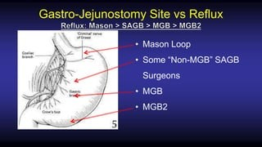
OAGB/MGB: what's new SICOB 2026 Pisa
Notes:
<number>
<number>
<number>
<number>

Slide 5
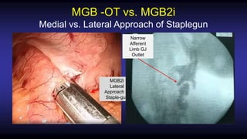
OAGB/MGB: what's new SICOB 2026 Pisa
Notes:
<number>
<number>
<number>
<number>

Slide 6
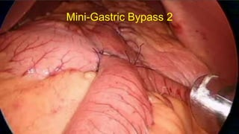
OAGB/MGB: what's new SICOB 2026 Pisa
Notes:
<number>
<number>
<number>
<number>

Slide 7
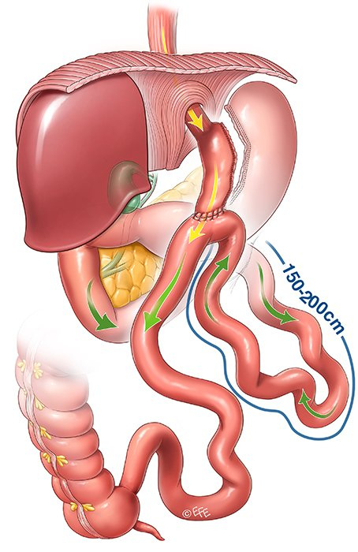
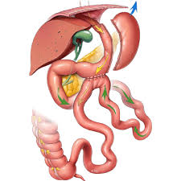
OAGB/MGB: what's new SICOB 2026 Pisa
Notes:
<number>
<number>
<number>
<number>

Slide 8
OAGB/MGB: what's new SICOB 2026 Pisa
MGB (mini gastric bypass)
MJB (Mini Jejunal bypass)
Notes:
<number>
<number>
<number>
<number>

Slide 9
OAGB/MGB: what's new SICOB 2026 Pisa
MJB: Surgical technique as adherent as possible to the Rutledge original MGB principles
Restriction and no obstruction
Wide anastomosis
Counting the bowel length from LOT
Not mesuring the whole bowel
No closure of Petersen defect
Notes:
<number>
<number>
<number>
<number>

Slide 10
OAGB/MGB: what's new SICOB 2026 Pisa
MJB
Sleeve like gastric resection (not a standard sleeve gastrectomy).
Antral sparing: resection starts at 8 cm from pylorus
Soft long gastric tube ( on a 38/40 fr calibration bougie)
resection at 3-5 cm from E-G Junction
Notes:
<number>
<number>
<number>
<number>

Slide 11
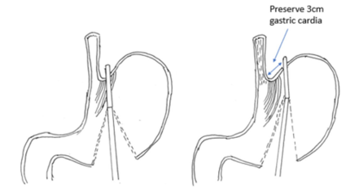
OAGB/MGB: what's new SICOB 2026 Pisa
MJB
Preserving the sling fibers
Do not touch the fat pad
Do not treat small hiatal hernias
Notes:
<number>
<number>
<number>
<number>

Slide 12
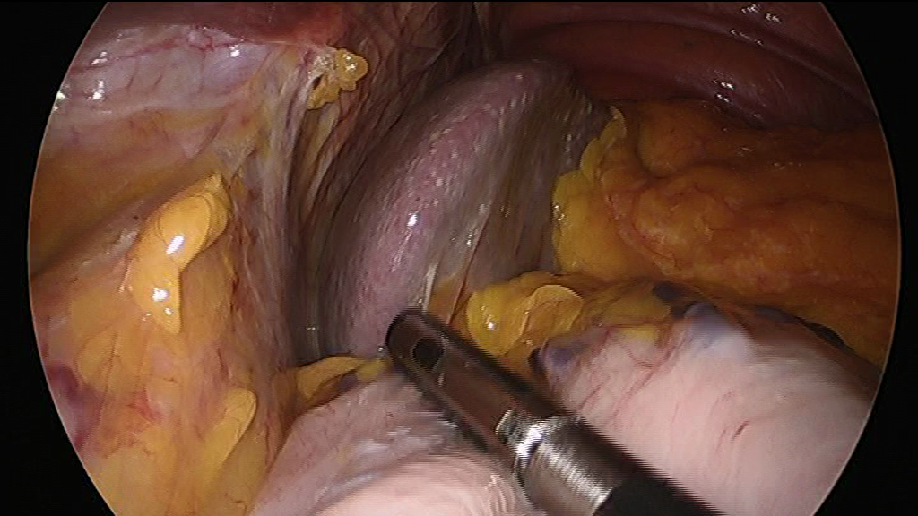
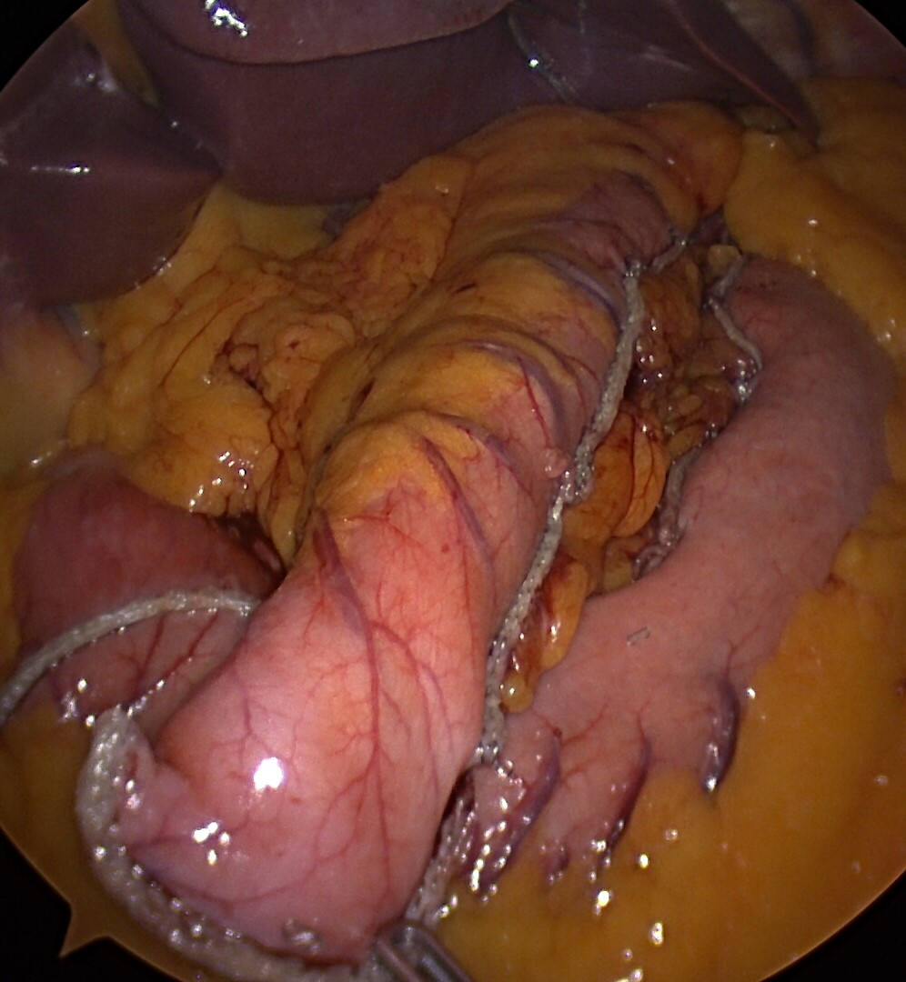
OAGB/MGB: what's new SICOB 2026 Pisa
Foto sleeve
Notes:
<number>
<number>
<number>

Slide 13
OAGB/MGB: what's new SICOB 2026 Pisa
Jejunal bypass: lenght of jejunum 2,5-3 m (AI)
Dr.Tacchino (SOARD 2015)
mean minimum maximum
SBL (cm) 690.1 350 1050
JLe (cm) 170.4 110 265
JLe may be a strong predictors of weight
Notes:
<number>
<number>
<number>

Slide 14
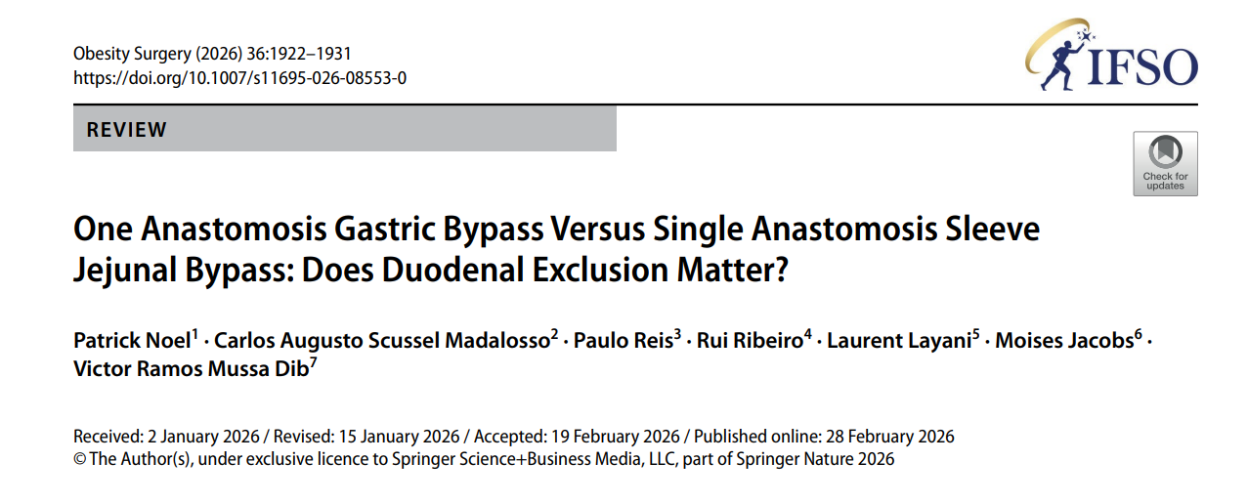
OAGB/MGB: what's new SICOB 2026 Pisa
Notes:
<number>
<number>

Slide 15
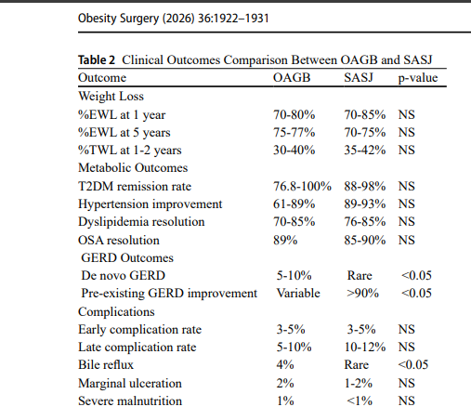
OAGB/MGB: what's new SICOB 2026 Pisa
Notes:
<number>
<number>

Slide 16
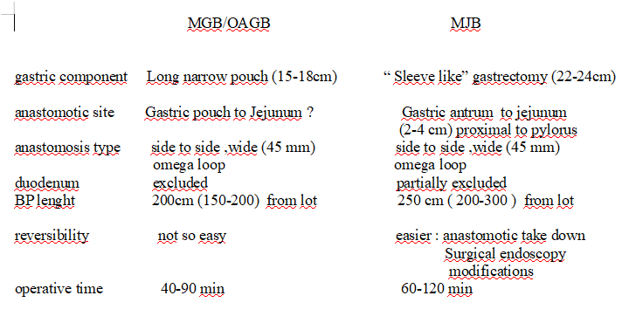
OAGB/MGB: what's new SICOB 2026 Pisa

Slide 17
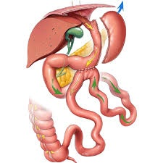
OAGB/MGB: what's new SICOB 2026 Pisa
MINI JEJUNAL BYPASS
MJB
3-5 cm
22-24 cm
4,5 cm
2 cm
2-3 m

Slide 18

OAGB/MGB: what's new SICOB 2026 Pisa
Thank you all

